Slide 1
Welcome to Holicong Parent Council
Please grab a snack and sit up front…and write a thank you or check out the website

Slide 2
Holicong Parent Council
September 19, 2019

Slide 3
How we want students to feel…

Slide 4
Parent Council – 5 W’s
Who: Open to ALL Holicong parents
What: Meetings based to inform, educate, gain feedback, & collaborate with Holicong community
When: Monthly meetings at 9:00 on 3rd Thursday of month (night meetings as well)
Where: Holicong
Why: Strengthen the partnership between the school and local community by sharing what is happening at Holicong, CBSD, in the local and national community, and all other areas that will help us raise our children and embody the values and goals
How: Let’s Find Out!

Slide 5
Parent Advisory Team Thank you to..
Holicong Community Involvement & Feedback Form
(click above to “get in the game” at Holicong!

Slide 7
Student Activities
Student Activities Fair
Who: All students rotate through
What: Opportunity for all students to see clubs & activities offered – and SIGN UP!
When: Friday, September 27th
Where: Holicong cafeteria & commons
Why: Students involved at school EQUALS
Healthier socially and emotionally
Connected to peers & community
Higher academic achievement
Our Activities!
Student Council
Representatives in Advisory
First 5 Committees
Student Activities Fair
First Responders Lunch
KvT
Magazine Drive
Spirit Week

Slide 9
What SHOULD I do in honor of Patriot Day?
Share the practice of “oral history” by asking those who experienced 9/11/2001 in attempts to relate to their experiences and feelings. (This is where a fabulous student says, “Teacher? Can you tell us about your experience with 9/11/2001?”)
Do something to support those who currently serve and protect our nation!! Could you help do something nice for Holicong’s very own Mr. Kibbe?

Slide 10
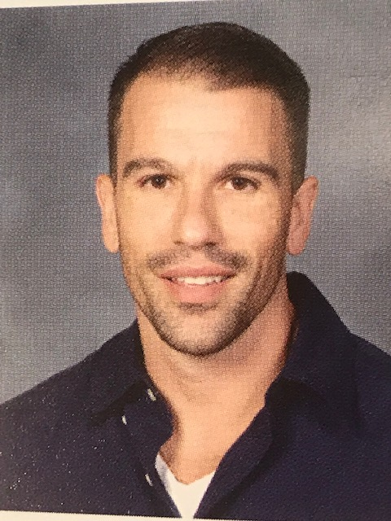
Our Mr. Kibbe
Army Captain (over 6-years of service).
Left Holicong Tech classes this past May for deployment to the Middle East.
Would appreciate your support!

Slide 11
What can we do now?
According to MILITARY.COM, there are many items that make our military men and women more comfortable and feel more appreciated.
Here are the items that we will be collecting in honor of “Patriot Day”:
Prefer to write a letter of support/make card? You can create these in Advisory and send them along!
7th Grade 8th Grade 9th Grade
Gum Q-Tips Shaving cream (non-aerosol)
Mints Shampoo First aid kits
Tea Bags Mouthwash Foot powder
Energy Bars Disposable razors Letter-writing supplies
Toothbrushes Lip balm Books
Toothpaste Eye drops Frisbees/balls
Playing cards Beef Jerky Nuts
Gummies Bubble Wrap $$ for shipping costs
$$ for shipping $$ for shipping Shipping boxes

Slide 12
Magazine Drive Timeline
Kickoff assembly Friday, Sept. 20th
1st Collection day Friday, Sept. 27th
2nd Collection Day Friday, Oct. 4th
Eagles Experience TBD

Slide 13
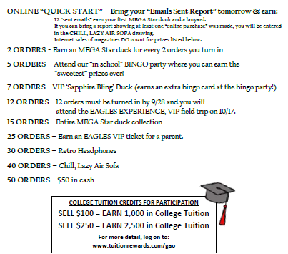
Cumulative Prizes

Slide 14
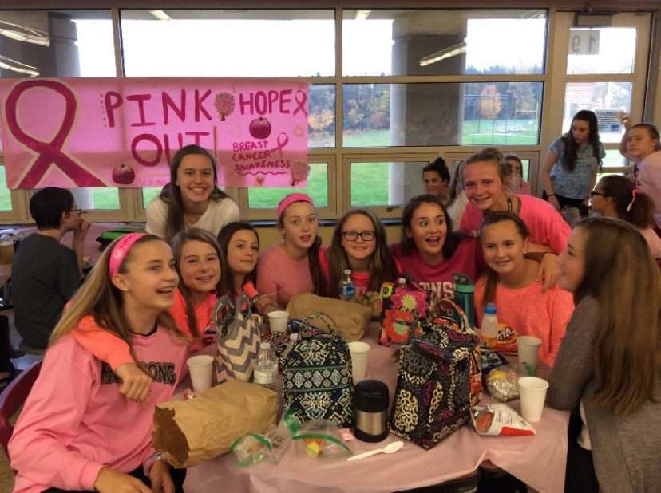
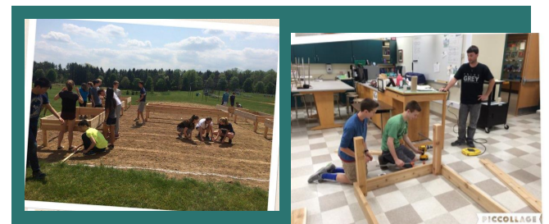
What do we do with Magazine Money?

Slide 15
Magazine Drive Volunteers
Volunteers needed after turn in days - on volunteer form
Help counting money, orders and distributing prizes
Sign up sheet available at today’s meeting

Slide 16
Summer Reading
Please welcome…
Mrs. Wentz

Slide 17
Holicong’s Summer Read
Our goals:
Build community
Reignite the spirit of the Daily Read
Offer more and varied choices
Read and talk

Slide 18
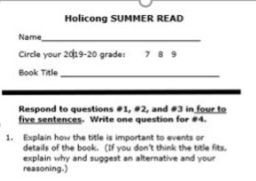
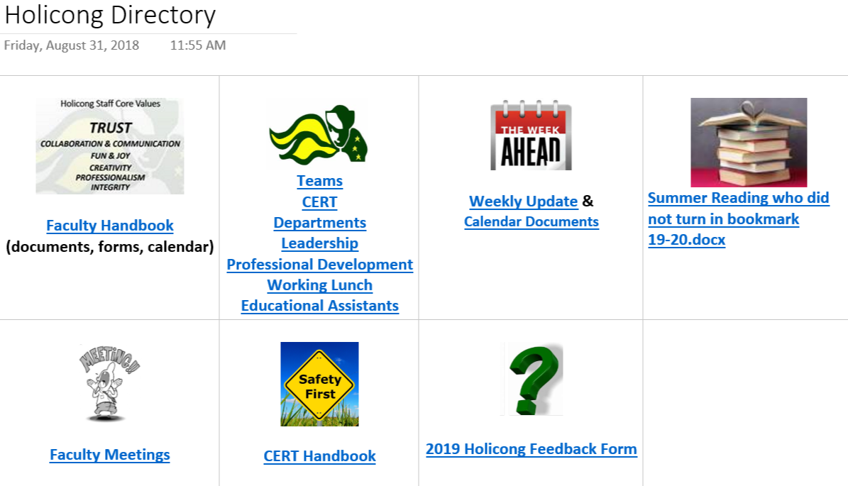
Bookmark
Students will complete bookmark & turn this into Advisory teachers to participate in discussion
Slips collected from 9/11- 9/18 & turn into the library (please make sure student name and book title is legible)
Note students who DID NOT turn in the bookmark in OneNote by 9/18

Slide 19
Dates to remember
September 11th -18th - Turn in bookmarks to the library (teacher collects and sends a student to library) & list students who did not complete in OneNote (on the Holicong OneNote homepage) Summer Reading who did not turn in bookmark 19-20.docx
September 24th - Rosters for book club distributed to teachers
September 25th - Book club discussion (extended Advisory schedule)

Slide 20
SAFETY at Holicong What is ALICE?
Alert
Lockdown
Inform
Counter
Evacuate
ALICE Resources
ALICE – Overview for Students
ALICE – CBSD Parent FAQ
ALICE – Main Website

Slide 21
SAFETY at Holicong What is CERT?
Critical
Event
Response
Team
Who: Staff, Administration, & Local 1st Responders
What: Team that reviews safety & security procedures and leads student and staff training
When: Quarterly meetings
Where: Holicong MS
Why: To ensure we are implementing current best practices in school safety, reviewing our own practices and needs, planning future drills, receiving trainings from experts, and collaborating with local law enforcement.

Slide 22
CANVAS LMS
Please welcome…
Mrs. Hallman, Mrs. Swidorski, and Ewan

Slide 23
CANVAS LMS
STUDENT
VIEW
PARENT
VIEW

Slide 24
CURRICULUM SPOTLIGHT MUSIC
Please welcome…
Mrs. Repper
Mr. Chodoroff
Mr.Glaser

Slide 25
Music @ HOLICONG
Parent Council 9/19/2019

Slide 26
Student PARTICIPATION IN BAND, CHOIR AND ORCHESTRA
7th Grade
235 students
8th Grade
186 students
9th Grade
162 students
583 total students involved in band, choir & orchestra classes.
Approximately 200 students annually participate in our co-curricular music groups.

Slide 27
GROUPS & CONCERTS AT A GLANCE
Curricular Groups
7th Grade Band
8th Grade Band
9th Grade Band
7th Grade Chorus
8th Grade Choir
9th Grade Choir
7th Grade Orchestra
8th Grade Orchestra
9th Grade Orchestra
Co-Curricular Groups
Robe Choir
H-Factor
Nothin’ But Treble
String Ensemble
Chamber Strings
Jazz Band
Wind Ensemble
Extra-Curricular Music Activites
Fall Coffeehouse Night
School Musical - Xanadu
Because we have so many groups, we have 4 winter concerts and 4 spring concerts!

Slide 28
USING TECHNOLOGY IN MUSIC
Teacher Websites
Information, rehearsal calendars, practice tracks
Canvas
Assignment calendars, practice quizzes, in-class quizzes
OneNote
Chorus Class – notes, assignments, sheet music
Flipgrid
Video submissions & teacher feedback
Remind
Quick easy reminders and communication with parents & students
Twitter
Keep up with happenings and pictures from the music department
@holicongmusic, @HolicongChoir, @HFactor17

Slide 29
7th GRADE MUSIC KICKOFF NIGHT TUESDAY, SEPTEMBER 24th
5:30-6:15pm students rehearse the Holicong Alma Mater
6:15pm pizza provided by us ☺
7pm Directors Presentation
Get to know the directors and learn about all things music at Holicong
To close the evening, students PERFORM the Holicong Alma Mater together!

Slide 30
NEW THIS YEAR: 9th GRADE GUITAR ELECTIVE
½ year A/B elective course for 9th Graders
Intended for both beginners and experienced
Great mix of students
Band, Choir & Orchestra kids who want to do even more with music
Students who are not a part of our performing ensembles getting a musical experience in 9th grade
CB purchased new acoustic guitars for each middle school so the students can learn on high quality instruments
Also will incorporate electric guitar & electric bass

Slide 31
CB SAVE THE MUSIC CONCERTS
Community building, philanthropic weekend of themed concerts that benefits VH1 Save the Music Foundation
Raised $198,495.71 since concert’s inception
Last two years, raised over $35k each year for schools in New Orleans
Thurgood Marshall Academy
Robert Russa Moton Charter School
This years shows are the weekend of January 24th and 25th
Theme announced soon
Tickets go on sale in mid-December

Slide 32
NEXT MEETING AGENDA
VAPING
Assessment & Grading Practices
Curriculum Spotlight: InC

Slide 33
Holicong Parent Council
September 19, 2019

